Slide 1
Course Title - Web System Engineering
Topic Title - REDUX store using the official create store function
Presenter’s Name - M ArunKumar
Presenter’s ID - IARE11151
Department Name - CSE ( Artificial Intelligence, and Machine Learning )
Lecture Number - #
Presentation Date - ##/04/2025

Slide 2
REDUX store using the official create store function
Redux is a JavaScript library that manages state in React applications. It's a key part of the React ecosystem, and is often used by frontend engineers to build complex applications.
How does Redux work?
Redux provides a centralized store for application state
Actions trigger state changes, such as when a user clicks a button
Reducers process the action and update the store
This predictable pattern makes it easier to debug and test applications
Benefits of Redux
Helps applications behave consistently
Helps applications run in different environments (client, server, and native)
Makes applications easier to test
Provides a great developer experience

Slide 3
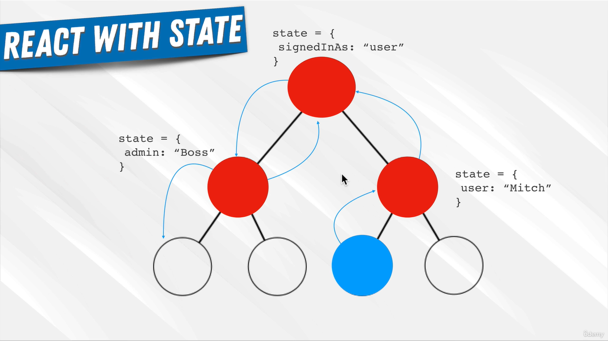
REDUX store using the official create store function
Redux and React integration
React-Redux is the official binding library that integrates Redux with React
React-Redux helps React components interact with the Redux store

Slide 4
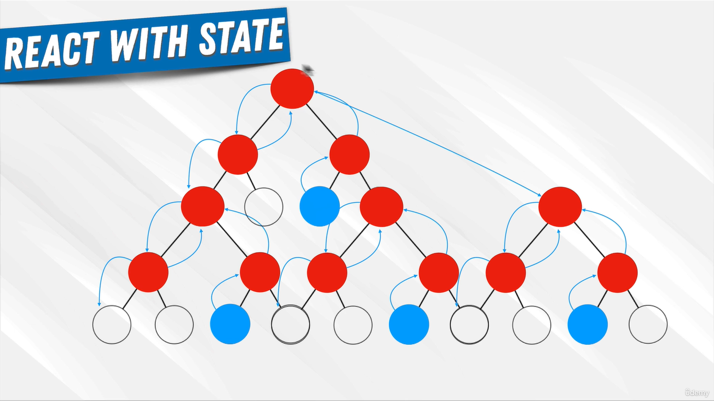
REDUX store using the official create store function

Slide 5
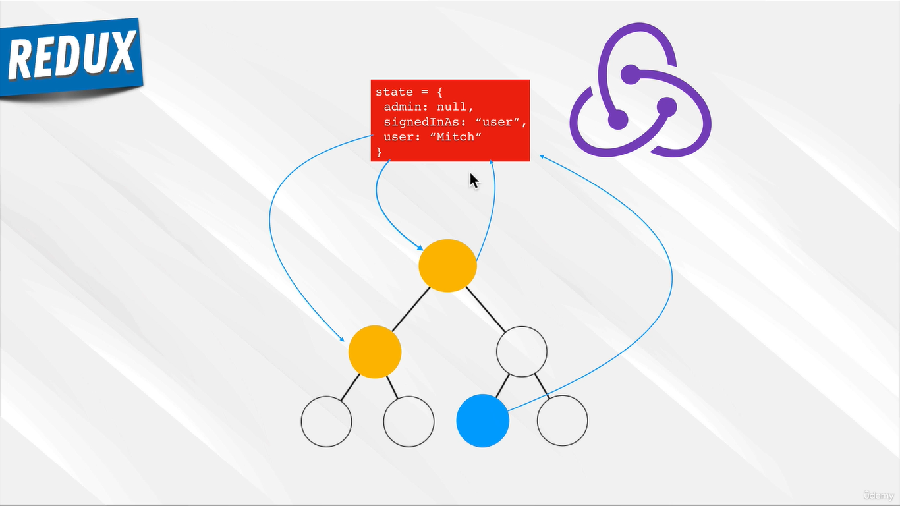
REDUX store using the official create store function

Slide 6

REDUX store using the official create store function

Slide 7
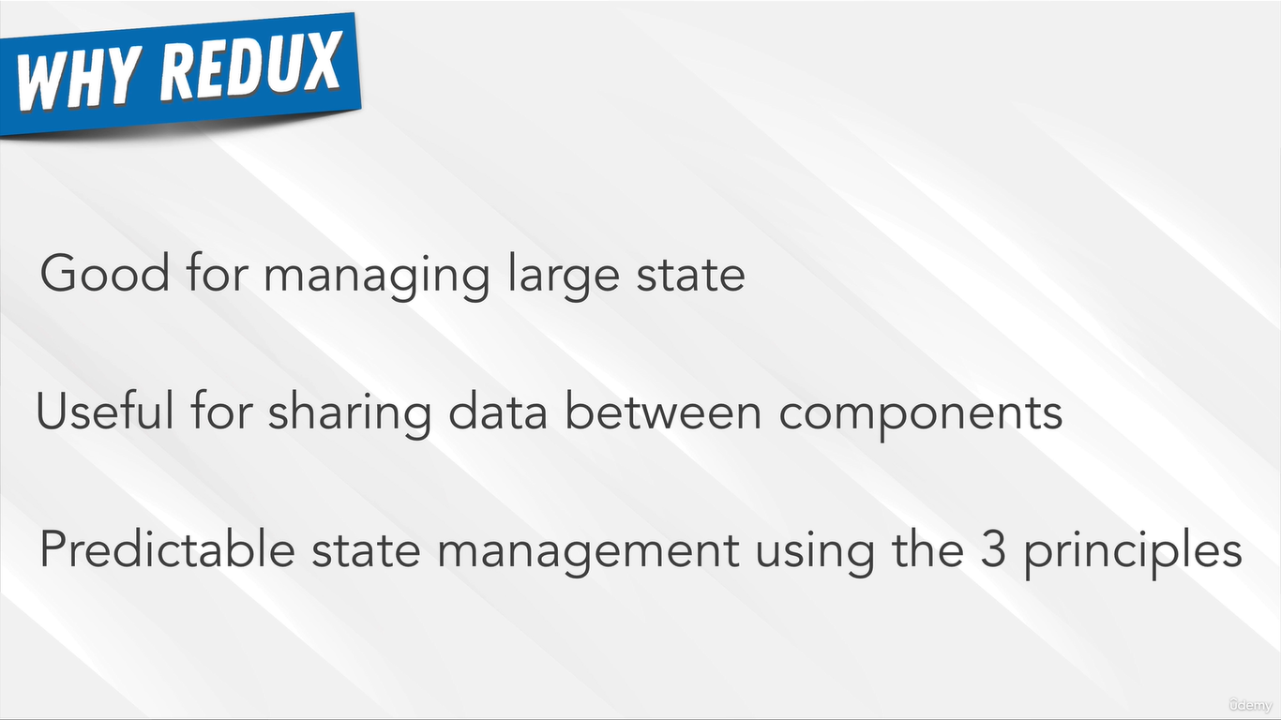
REDUX store using the official create store function

Slide 8

REDUX store using the official create store function

Slide 9
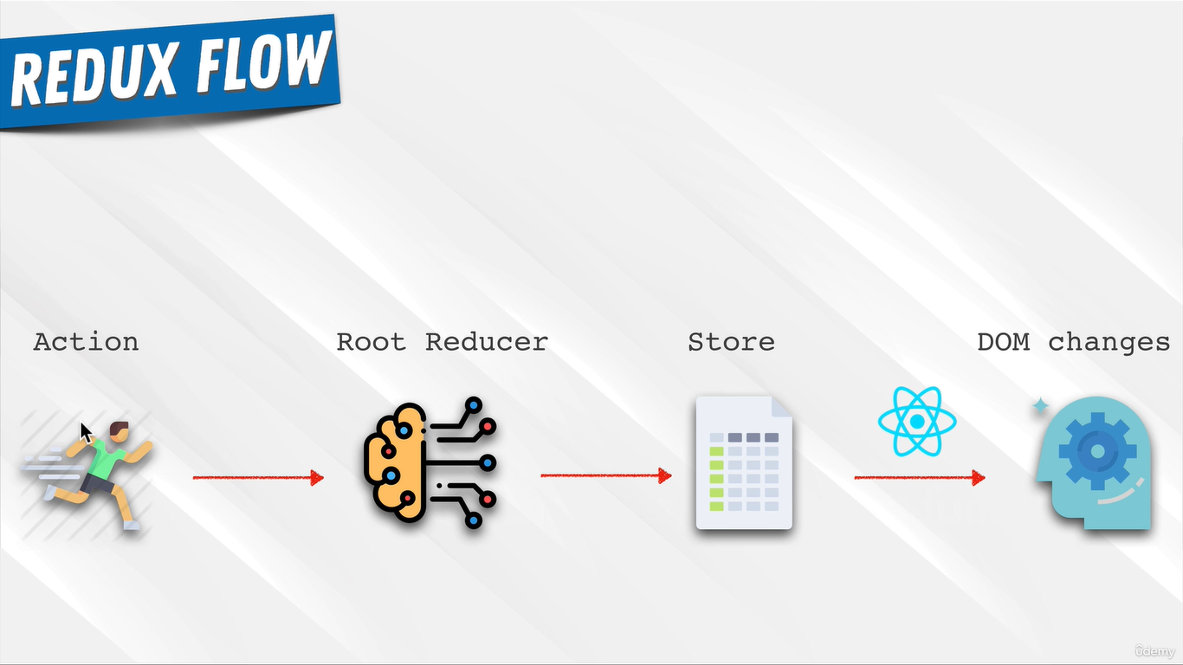
REDUX store using the official create store function

Slide 10
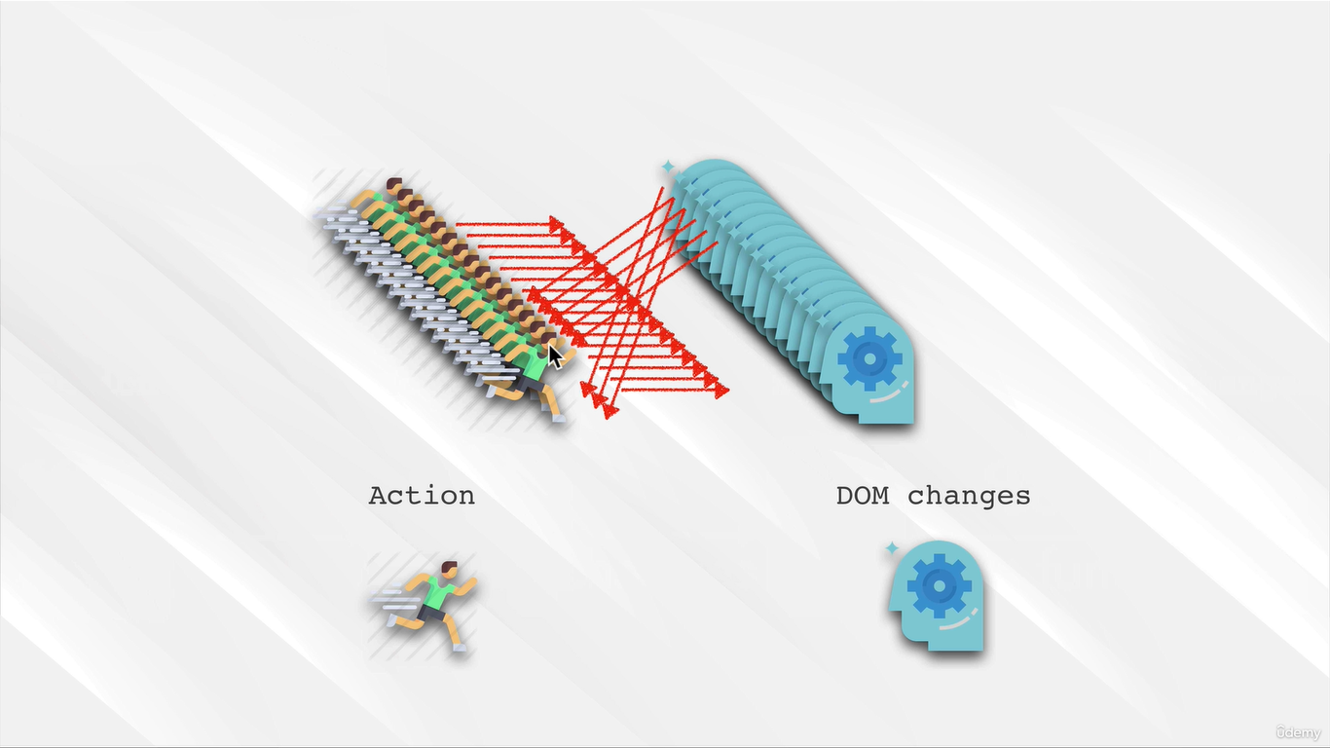
REDUX store using the official create store function
Jquery State flow disgram

Slide 11
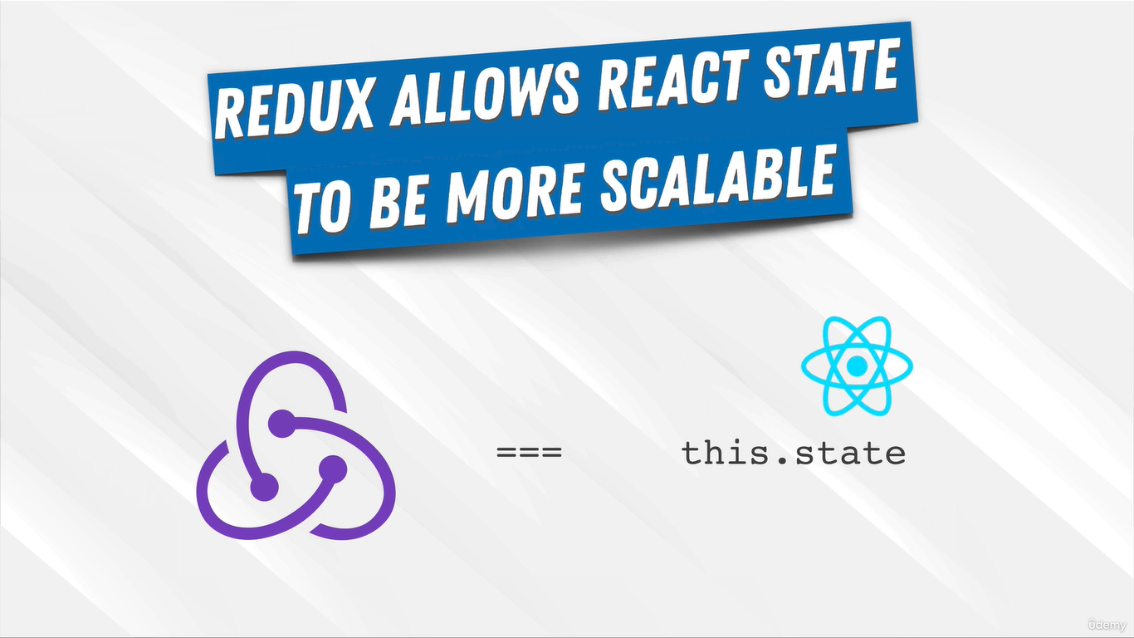
REDUX store using the official create store function

Slide 12
REDUX store using the official create store function
Step 1: Setting up Redux Store with createStore
First, you'll need to install redux if it's not already part of your project. You can install it via npm:
npm install redux
Then, you can create the Redux store using the createStore function like this:
store.js

Slide 13
REDUX store using the official create store function
Step 2: Integrating Redux into your React Application
You’ll need to wrap your application with the Provider component from react-redux to give your app access to the Redux store.
index.js (React App Entry Point)

Slide 14
REDUX store using the official create store function
Step 3: Using Redux Store in React Components
You can now use the Redux store in your React components using the useSelector and useDispatch hooks from react-redux.

Slide 15
Thank You

